Slide 1
Self-healing and self-optimization in mRUBiS
Sona Ghahremani
sona.ghahremani@hpi.de
Notes:
https://en.wikipedia.org/wiki/Transduction_(machine_learning)

Slide 2



mRUBiS : Modularized Self-adaptive System
Adaptation Engine
modular Rice University Bidding System
Used to evaluate application design patterns and application servers performance scalability
An online marketplace with multiple shops modeled after ebay
Individual shops have different configurations, run independently from each other but are jointly hosted and controlled.
https://www.hpi.uni-potsdam.de/giese/public/mdelab/mdelab-projects/case-studies/mrubis/
Thomas Vogel. 2018. MRUBiS: an exemplar for model-based architectural self-healing and self-optimization. In Proceedings of the 13th International Conference on Software Engineering for Adaptive and Self-Managing Systems (SEAMS ’18). Association for Computing Machinery, New York, NY, USA, 101–107. DOI:https://doi.org/10.1145/3194133.3194161

Slide 3
Architecture of a single shop in mRUBiS

Slide 4
Architecture of the Market Place
A single adaptation engine comprising feedback loops that realize the self-healing and self-optimization capabilities controls all mRUBiS instances.

Slide 5
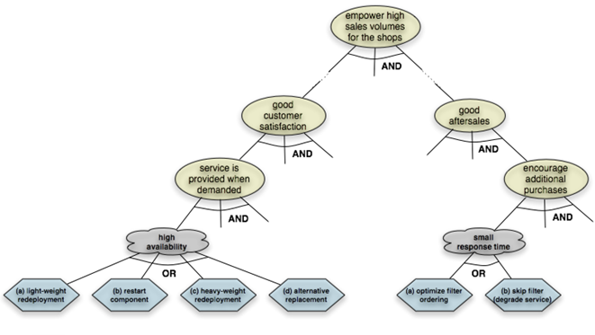
-mRUBiS Goal Model
Following a Goal-based approach focused on fulfilling the soft goals of High availability and Low response time via self-* properties.
Self-healing
Self-optimization

Slide 6
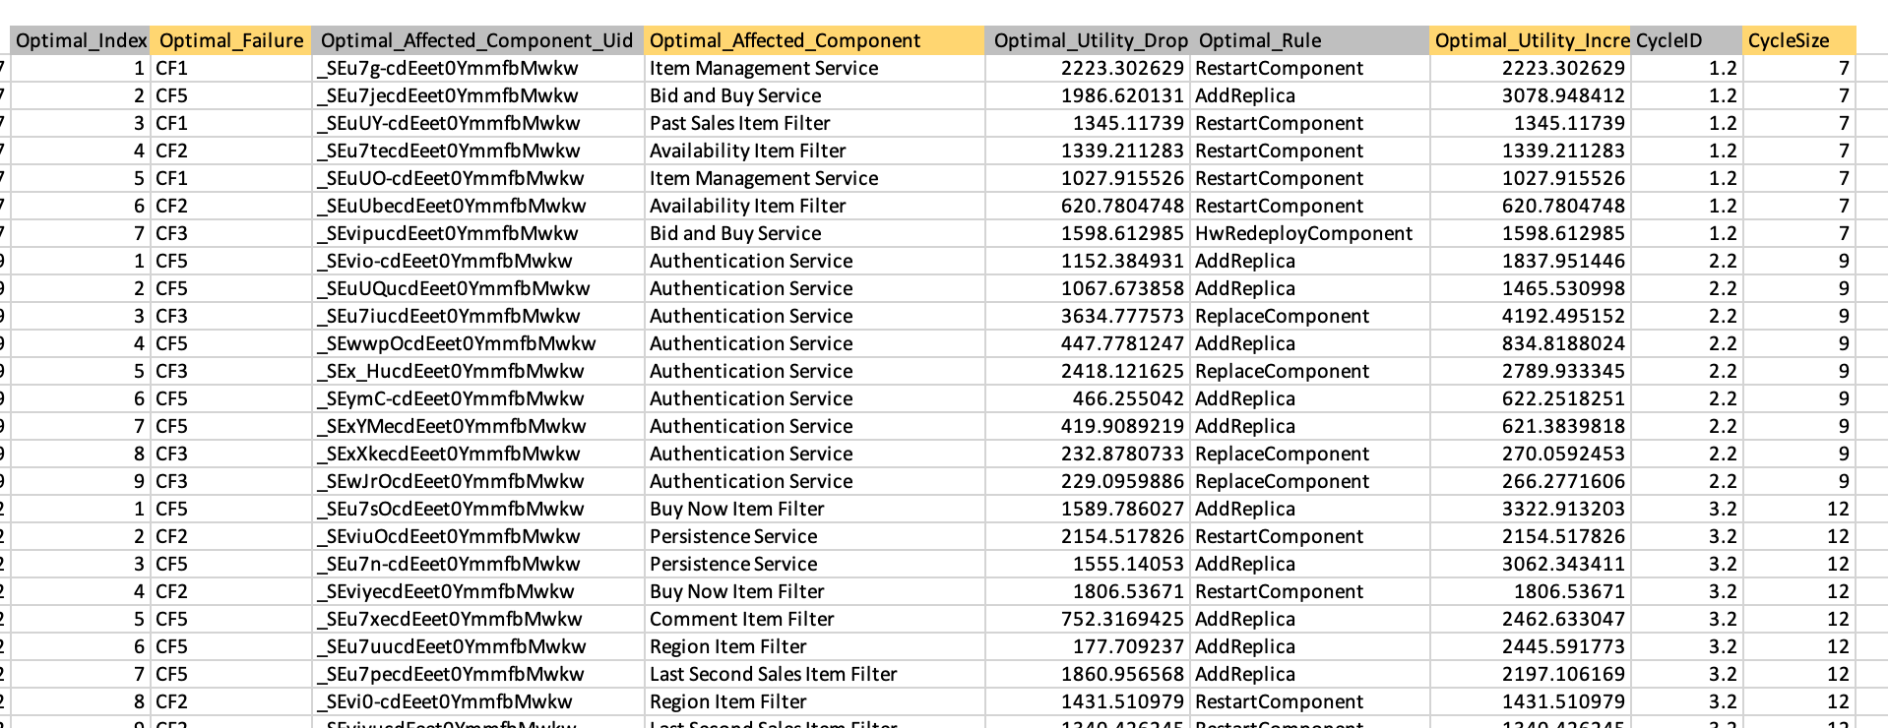
Data Used for the Implementation

Slide 7

Failures and Affected Components
Adaptation Engine
Affected Component
Affected Component Uid:
(_SEu7n-cdEeet0YmmfbMwkw )
Failures
Critical Failure Types:
CF1 : Component crashes
CF2 :Component throws exceptions
CF3 :Component is undeployed
CF5 : Change in the system load

Slide 8
Utility Drop
Utility
Utility (optimal)
CF1
Dropped U ₁
CF5
Dropped U ₂
CF1
Dropped U ₃
Time

Slide 9

Optimal Rule
Utility
Utility (optimal)
Set of repair Rules
CF1
Dropped U ₁
Mark the triggered rules
CF5
Applicable Rules
Not applicable
Dropped U ₂
CF1
Dropped U ₃
Time

Slide 10
Optimal Rule
Utility
Restart Component
Heavy Weight Redeployment
Light weight Redeployment
Replace Component
Utility (optimal)
CF1
Dropped U ₁
Add Replica
Remove Replica
CF5
Dropped U ₂
CF1
Dropped U ₃
Time

Slide 11
Optimal Rule and Utility Increase
Utility
Add Replica
Utility (optimal)
Restart
CF1
Dropped U ₁
Add Replica
Replace
CF5
HW Redeployment
LW Redeployment
Dropped U ₂
CF1
Dropped U ₃
Time

Slide 12
Optimal Index ( Ordering of the Rules)
Reward : Utility Over Time
1-Heavy Weight Redeployment
2-Restart Component
3-Add Replica
Utility
Add Replica
Utility (optimal)
Restart
CF1
HW Redeployment
Dropped U ₁
Lost Reward
CF5
HW Redeployment
Restart
1- Add Replica
2-Restart Component
3- Heavy Weight Redeployment
Dropped U ₂
CF1
Add Replica
Dropped U ₃
Time

Slide 13
Data Used for the Implementation

Slide 14
Stochastic Environment -> Online Learning
Failures can cause different effects (utility drops) on the same component due to changing environment and system configuration
Repair rules can cause different affects (utility increases) on the same component due to changing environment and system configuration
The applicability of the rules for (component, failure) pair can also change

Slide 15
End

